Slide 1



Team Name: Alpha
Title : Emergency Response Web-App for Ambulance Drivers

Slide 2


“Do you know that 40 patients died within 3 weeks in England in December 2021” The deaths occur due to delays of ambulances and also the unavailability of beds in hospitals and the result is huge number of loss of life. Hence, We identified this problem and find possible solution using Software Development to cater this problem
PROBLEM
sds
2

Slide 3
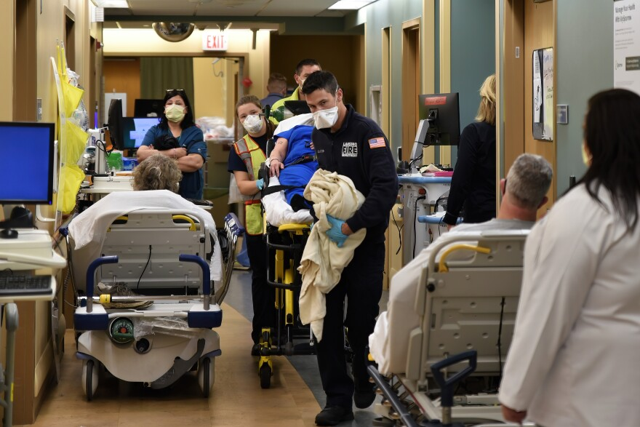
CAUSES OF DELAY
1. The Ambulance driver forgets the location of the hospital.
2. The Ambulance Driver unable to determine whether the hospital will admit patient or not.
3. The hospital cannot admit patient due to shortage of beds.
4. The driver travels over multiple hospitals until patient will not get admit.

Slide 4

Solution
1. There will be a web-App product for an emergency response to the ambulance driver
2. The Driver contains an application that is made up of two screens.
3. First: This screen will show all the nearby hospitals with allocated and free beds.
4. second: This screen contains the form filled by the driver so that hospital can determine that condition and situation of patient
5. The Hospital contains a web application. This stockholder also contains two pages.
6. First: The ambulances coming toward that hospital
Second: Data sent by driver This help to provide availability of equipment
4

Slide 5
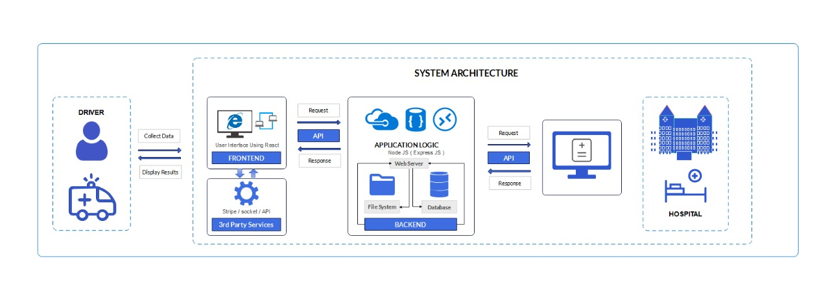
PRODUCT DESIGN

Slide 6

The Business Model
The Provided product is basically a service-based platform where we provide our stakeholders’ availability with confidentiality. The users can ask for trail version of our product and afterwards, The product needs monthly subscription by the user. The revenue will be generated through every driver and makes company a profitable business.
HOSPITAL INTEREST:
1. Ease of communication.
2. Easily Share and get details.
3. Determines which ambulance
moving toward the hospital.
4. Maintain Availability for patient
DRIVER INTEREST:
1.Ease of communication
2.Time saving
3. Predict which hospital to move
4. Reward for saving life

Slide 7
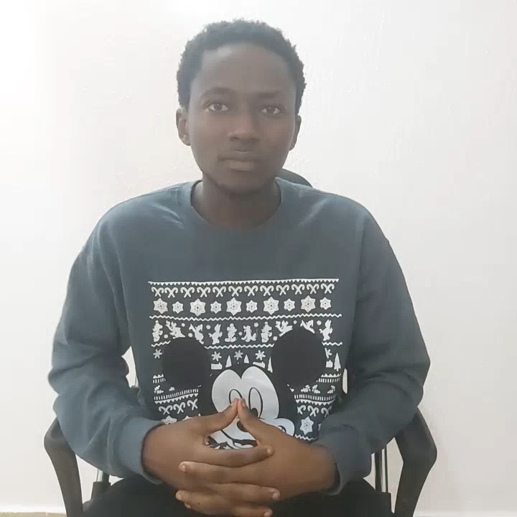
VIDEO PRESENTATION

Slide 8


